Slide 1
Discrete Mathematics (CSC 1204)
8.4 Connectivity
8.5 Euler and Hamilton Paths

Slide 2
Paths
A path is a sequence of edges that begins at a vertex of a graph and travels from vertex to vertex along edges of the graph.

Slide 3
Paths
Definition1: Let n be a nonnegative integer and G an undirected graph. A path of length n from u to v in G is a sequence of n edges e₁, e₂ , …., e_{n} of G such that
e₁ is associated with {x₀, x₁}, e₂ is associated with {x₁, x₂ }, and so on, with e_{n} associated with {x_{n-1}, x_{n} }, where x₀=u and x_{n}=v.
The path is a circuit if it begins and ends at the same vertex, that is, if u = v, and has length greater than zero.
The path or circuit is said to pass through the vertices x_{1,} x_{2, …,} x_{n-1} or traverses the edges e₁, e₂ , …., e_{n} .
A path/circuit is simple if it does not contain the same edge more than once.

Slide 4
Paths in Directed Graph
Same as in undirected graphs, but the path must go
in the direction of the arrows.

Slide 5
Connectedness in Undirected Graphs
An undirected graph is called connected if there is a path between every pair of distinct vertices of the graph

Slide 6
In the simple graph shown in Figure, a , d, c, f, e is a simple path of length 4, because {a , d}, {d, c } , {c, f}, and { f, e} are all edges.
However, d, e, c, a is not a path, because {e, c} is not an edge.
Note that b, c, f, e, b is a circuit of length 4 because {b, c}, {c, f}, {f, e}, and {e, b} are edges, and this path begins and ends at b.
The path a, b, e, d, a, b, which is of length 5, is not simple because it contains the edge {a, b} twice.

Slide 7
Example 6 (p.563)
Figure 3: The Graphs G ₁ and G₂
The graph G _{l} in Figure 3 is connected, because for every pair of distinct vertices there is a path between them.
However, the graph G ₂ in Figure 3 is not connected. For instance, there is no path in G2 between vertices a and d.

Slide 8
Connectivity
Question: Which of the following graphs are connected?
1
2
3
4

Slide 9
Connectivity
Answer: First and second are disconnected. Last one is connected.
1
2
3
4

Slide 10
Connected Components
A connected component of a graph G is a connected subgraph of G that is not proper subgraph of another connected subgraph of G.
A connected component of a graph G is a maximal connected subgraph of G.
A graph G that is not connected has two or more connected components that are disjoint and have G as their union

Slide 11
Connected Components
Definition: A connected component in a graph G is a set of vertices such that all vertices in the set are connected to each other and every possible connected vertex is included.
Question : What are the connected components of the following graph?
1
6
2
7
8
5
3
4

Slide 12
Connected Components
Answer: The connected components are {1,3,5}, {2,4,6}, {7} and {8} as one can see visually by pulling components apart:
1
6
2
8
7
5
3
4

Slide 13
Connectedness in Directed Graphs
A directed graph is strongly connected if there is a path from a to b and from b to a whenever a and b are vertices in the graph.
For a directed graph to be strongly connected there must be a sequence of directed edges from any vertex in the graph to any other vertex
A directed graph is weakly connected if there is a path between every two vertices in the underlying undirected graph.
Note: Any strongly connected directed graph is also weakly connected, but the opposite is not true.

Slide 14
EXAMPLE: Are the directed graphs G and H shown in Figure strongly connected? Are they weakly connected?
Weakly Strongly
Connected Connected
G H
H is strongly connected because there is a path between any two vertices in this directed graph. Hence, H is also weakly connected.
The graph G is not strongly connected. There is no directed path from a vertex to other vertex in this graph.

Slide 15
Example
Graph G is strongly connected (hence G is also weakly connected). Graph H is not strongly connected, however H is weakly connected.
a b a b
c
c
e d e d
Graph G Graph H

Slide 16
Paths and Isomorphism
There are several ways that paths & circuits can help determine whether two graphs are isomorphic.
For example, the existence of a simple circuit of a particular length is a useful invariant that can be used to show that two graphs are not isomorphic
A useful isomorphic invariant for simple graphs is the existence of a simple circuit of length k, where k is a positive integer greater than 2.

Slide 17
Graph Isomorphism – Example
Determine whether the graphs G and H are isomorphic.
G H
v₂
u₂
v₁
v₃
u₁
u₃
v₅
v₄
u₅
u₄

Slide 18
Solution
At first, you check all the graph invariants between
the two graphs you know so far. If there is any mismatch, then
the graphs are not isomorphic.
However, if all the graph invariants are same, then you go for
mapping (i.e., mapping the vertices of one graph to another).
Here, all the graph invariants are same (you check it!).
Now you go for mapping…
f (v₁) = u₁ , f (v₂) = u₃ , f (v₃) = u₅ , f (v₄) = u₂ , f (v₅) = u₄
The function f is bijective (i.e., one-to-one as well as onto).
So the graphs G and H are isomorphic.

Slide 19
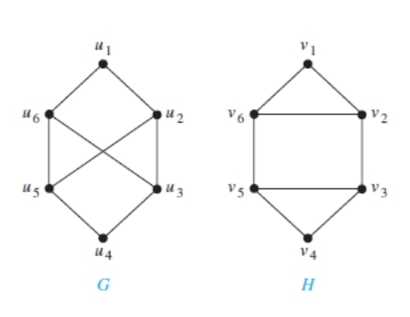
Example 14(p.565): Determine whether the graphs G and H shown in Figure 8 are isomorphic.
Figure 8

Slide 20
Solution
Both G and H have six vertices and eight edges.
Each has four vertices of degree three, and two vertices of degree two.
So, the three invariants –number of vertices, number of edges, and degrees of vertices —all agree for the two graphs. [Note: you must check other graph invariants too]
However, H has a simple circuit of length three, namely, v₁, v₂, v₆, v₁ , whereas G has no simple circuit of length three, as can be determined by inspection (all simple circuits in G have length at least four).
Because the existence of a simple circuit of length three is an isomorphic invariant, G and H are not isomorphic.

Slide 21
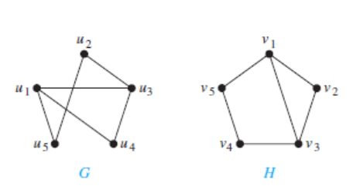
Example 15 (p.566) : Determine whether the graphs G and H shown in Figure 9 are isomorphic.
Figure 9

Slide 22
Solution
Both G and H have five vertices and six edges.
Each has two vertices of degree three, and three vertices of degree two.
Both have a simple circuit of length three, a simple circuit of length four, and a simple circuit of length five.
Because all these isomorphic invariants agree here, so
G and H may be isomorphic.
…..continued to next slide

Slide 23
Finding of possible isomorphism:
………. we will follow paths that go through all vertices so that the corresponding vertices in the two graphs have the same degree.
For example, the paths u₁, u₄,u₃, u₂, u₅ in G and v₃, v₂, v₁, v₅, v₄ in H both go through every vertex in the graph; start at a vertex of degree three; go through vertices of degrees two, three, and two, respectively; and end at a vertex of degree two.
By following these paths through the graphs, we can define the mapping f with
f (u₁) = v₃
f (u₂) = v₅
f (u₃) = v₁
f (u₄) = v₂
f (u₅) = v₄
It shows that f is an isomorphism, so G and H are isomorphic.

Slide 24
8.5 Euler and Hamilton Paths
Euler Paths & Circuits
Hamilton Paths & Circuits

Slide 25
Euler Paths & Circuits
Euler path: An Euler path in G is a simple path containing every edge of G.
Euler circuit: An Euler circuit in a graph G is a simple circuit containing every edge of G.

Slide 26
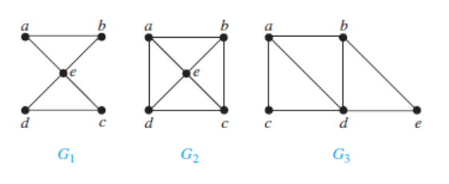
Euler Paths & Circuits
EXAMPLE 1 (p.572): Which of the undirected graphs in Figure below have an Euler circuit? Of those that do not, which have an Euler path?

Slide 27
Euler Paths & Circuits
Solution:
The graph G1 has an Euler circuit, for example, a, e, c, d, e, b, a.
Neither of the graphs G2 or G3 has an Euler circuit.
However, G3 has an Euler path, namely, a, c, d, e, b, d, a, b. G2 does not have an Euler path.

Slide 28
Euler Paths & Circuits
Theorem 1: A connected multigraph with at least two vertices has an Euler circuit iff each of its vertices has even degree.
Theorem 2: A connected multigraph has an Euler path (but not an Euler circuit) iff it has exactly two vertices of odd degree.

Slide 29
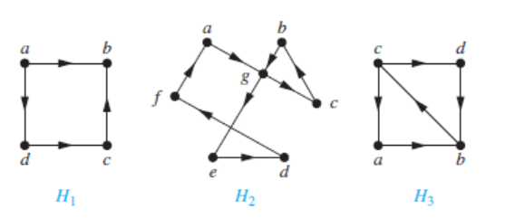
Determining Euler Circuit/Path: Example
EXAMPLE 2 (p.572): Which of the directed graphs in Figure 4 have an Euler circuit? Of those that do not, which have an Euler path?
Figure 4

Slide 30
Determining Euler Circuit/Path: Example
Solution:
The graph H₂ has an Euler circuit, for example,
a, g, c, b, g, e, d, f, a.
Neither H₁nor H₃ has an Euler circuit
H₃ has an Euler path, namely, c, a, b, c, d, b,
but H₁ does not have Euler path

Slide 31
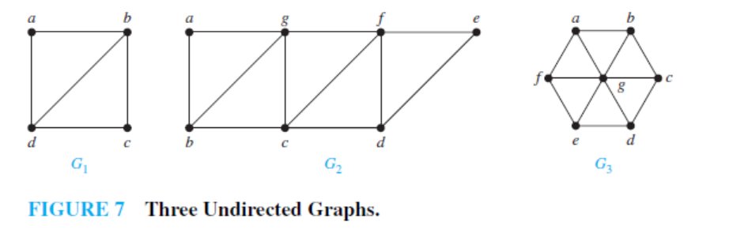
Determining Euler Circuit/Path: Example
Example 4(p.575):Which graphs shown in Figure 7 have an Euler path?

Slide 32
Determining Euler Circuit/Path: Example
Solution:
G₁ contains exactly two vertices of odd degree, namely, b and d. Hence, it has an Euler path that must have b and d as its endpoints.
One such Euler path is d, a, b, c, d, b.
Similarly,G₂ has exactly two vertices of odd degree, namely, b and d. So it has an Euler path that must have b and d as endpoints.
One such Euler path is b, a, g, f, e, d, c, g, b, c, f, d.
G₃ has no Euler path, because it has six vertices of odd degree.

Slide 33
Hamilton Paths and Circuits
Hamilton path: A simple path in a graph that passes through every vertex exactly once is called a Hamilton path.
Note: A Hamilton path does not necessarily pass
through all the edges of the graph
Hamilton circuit: A simple circuit in a graph G that passes through every vertex exactly once is called a Hamilton circuit.

Slide 34
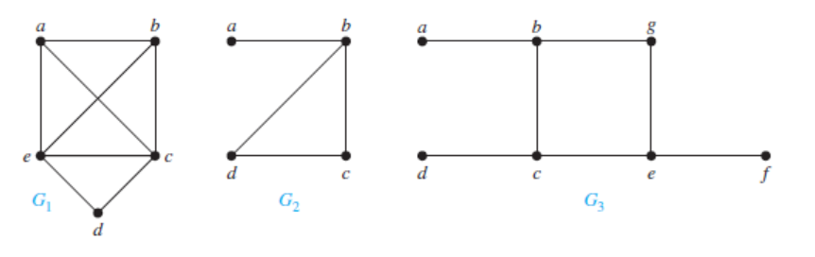
Hamilton Paths and Circuits
EXAMPLE 5(p.577): Which of the simple graphs in Figure 10 have a
Hamilton circuit or, if not, a Hamilton path?
Figure 10 : Three Simple Graphs

Slide 35
Hamilton Paths and Circuits
Solution:
G₁ has a Hamilton circuit: a, b, c, d, e, a.
There is no Hamilton circuit in G₂ (this can be seen by noting that any circuit containing every vertex must contain the edge {a, b} twice),
but G₂ does have a Hamilton path, namely, a, b, c, d.
G₃ has neither a Hamilton circuit nor a Hamilton path, because any path containing all vertices must contain one of the edges {a, b},{e, f }, and {c, d} more than once.

Slide 36
Necessary & Sufficient Criteria for Hamilton Circuits
There are NO known simple necessary and sufficient criteria for the existence of Hamilton circuits. However, many theorems are known that give sufficient conditions for the existence of Hamilton circuits.
Certain properties can be used to show that a graph has no Hamilton circuit. For instance, a graph with a vertex of degree one cannot have a Hamilton circuit, because in a Hamilton circuit, each vertex is incident with two edges in the circuit. Moreover, if a vertex in the graph has degree two, then both edges that are incident with this vertex must be part of any Hamilton circuit.
When a Hamilton circuit is being constructed and this circuit has passed through a vertex, then all remaining edges incident with this vertex, other than the two used in the circuit, can be removed from consideration.
A Hamilton circuit cannot contain a smaller circuit within it.

Slide 37
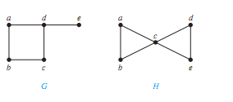
Hamilton Paths and Circuits
EXAMPLE 6 (p.577): Show that neither graph displayed in Figure 11 has a
Hamilton circuit.
Figure 11

Slide 38
Hamilton Paths and Circuits
Solution:
There is no Hamilton circuit in G because G has a vertex of degree one, namely, e.
Now consider H. Because the degrees of the vertices a, b, d, and e are all two, every edge incident with these vertices must be part of any Hamilton circuit. It is now easy to see that no Hamilton circuit can exist in H, for any Hamilton circuit would have to contain four edges incident with c, which is impossible.

Slide 39
Hamilton Paths and Circuits
Extra Question: Is there any Hamilton paths in those graphs of Example 6?
Answer: Yes, both graph contains Hamilton paths.
In graph G ➔ e, d, a, b, c
In graph H ➔ a, b, c, d, e
Question: What are other answers (paths)?

Slide 40
Hamilton Paths and Circuits
Theorem 3(DIRAC’S THEOREM): If G is a simple graph with n vertices with n>=3 such that the degree of every vertex in G is at least n/2, then G has a Hamilton circuit.
Theorem 4(ORE’S THEOREM): if G is a simple graph with n vertices with n>=3 such that
deg(u) + deg(v) >= n for every pair of non-adjacent vertices u and v in G, then G has a Hamilton circuit.

Slide 41
Hamilton Paths and Circuits
Both Ore’s Theorem and Dirac’s Theorem provide sufficient conditions for a connected simple graph to have a Hamilton circuit. However, these theorems do not provide necessary conditions for the existence of a Hamilton circuit.
For example, the graph C₅ has a Hamilton circuit but does not satisfy the hypotheses of either Ore’s Theorem or Dirac’s Theorem

Slide 42
Exercise 37 (p.583)
Does the following graph have a Hamilton path? If so, find such a path. If it does not, give an argument to show why no such path exists.
a d
c f
b e

Slide 43
Exercise 37 (p.645)
Solution:
This graph has the Hamilton path a, b, c, f, d, e.
This simple path hits each vertex once.
a d
c f
b e
Question: Does the above graph have Hamilton Circuit? Explain.

Slide 44
Euler vs. Hamilton Paths & Circuits
On the surface, there is a one-word difference between Euler paths/circuits and Hamilton paths/circuits: The former covers all edges; the latter covers all vertices.

Slide 45
Euler vs. Hamilton Paths & Circuits
Note: If a graph has a Hamilton circuit, then it automatically has a Hamilton path–the Hamilton circuit can always be truncated into a Hamilton path by dropping the last vertex of the circuit. (For example, the Hamilton circuit A, F, B, C, G, D, E, A can be truncated into the Hamilton path A, F, B, C, G, D, E.)
==> See next slide
Contrast this with the mutually exclusive relationship between Euler circuits and Euler paths: If a graph has an Euler circuit it cannot have an Euler path and vice versa.

Slide 46
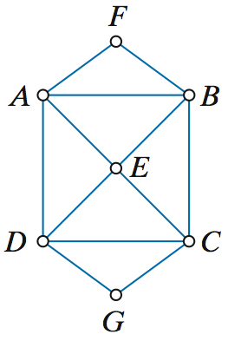
Hamilton vs. Euler
The figure shows a graph that (1) has Euler circuits (the vertices are all even-degree) and (2) has Hamilton circuits.
One such Hamilton circuit is
A, F, B, C, G, D, E, A – there are plenty more.
Can you identify an Euler circuit in this graph?

Slide 47
Practice @ Home
Relevant Odd-Numbered Exercises
19, 21, 30, 31, 35, 37, 39, 43, 47

